Slide 1

FACULTY OF INFORMATION TECHNOLOGY
Fall,2020
2017
MAT 207- LINEAR ALGEBRA
Lecture 2 - Linear equations in Linear Algebra
25/09/2021
Lecture 2 : Linear Equation in Linear Algebra
1

Slide 2
Content
1
Linear Independent ( độc lập tuyến tính )
2
Introduction To Linear Transformation( Biến đổi tuyến tính , ánh xạ tuyến tính, toán tử tuyến tính)
3
The Matrix Of Linear Transformation
25/09/2021
Lecture 2 : Linear Equation in Linear Algebra
2

Slide 3
Linear Independence
25/09/2021
Lecture 2 : Linear Equation in Linear Algebra

Slide 4
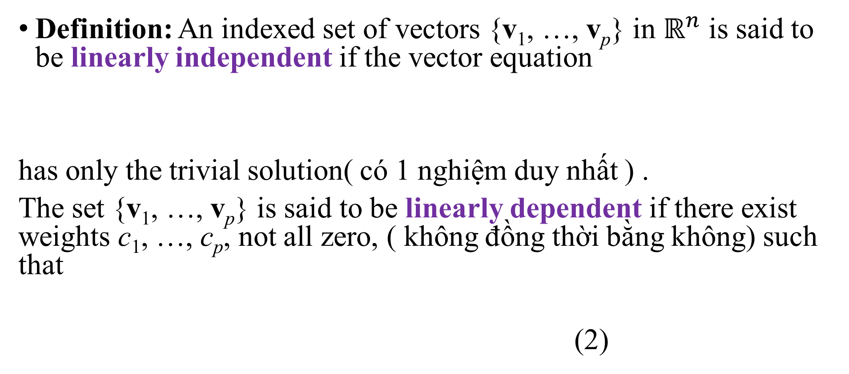
LINEAR INDEPENDENCE
Definition: An indexed set of vectors {v₁, …, v_{p}} in $ℝ^{n}$ is said to be linearly independent if the vector equation
has only the trivial solution( có 1 nghiệm duy nhất ) .
The set {v₁, …, v_{p}} is said to be linearly dependent if there exist weights c₁, …, c_{p}, not all zero, ( không đồng thời bằng không) such that
(2)
25/09/2021
Lecture 2 : Linear Equation in Linear Algebra

Slide 5
LINEAR INDEPENDENCE
Example 1: Let , , and
Determine if the set {v₁, v₂, v₃} is linearly independent.
If possible, find a linear dependence relation among v₁, v₂, and v₃.
25/09/2021
Lecture 2 : Linear Equation in Linear Algebra

Slide 6
LINEAR INDEPENDENCE
Solution: We must determine if there is a nontrivial solution of the equation on the previous slide.
x₁ and x₂ are basic variables, and x₃ is free.
Each nonzero value of x₃ determines a nontrivial solution of (1).
Hence, v₁, v₂, v₃ are linearly dependent.
25/09/2021
Lecture 2 : Linear Equation in Linear Algebra

Slide 7
LINEAR INDEPENDENCE
To find a linear dependence relation among v₁, v₂, and v₃, completely row reduce the augmented matrix and write the new system:
Thus, , , and x₃ is free.
Choose any nonzero value for x₃—say, .
Then and .
25/09/2021
Lecture 2 : Linear Equation in Linear Algebra

Slide 8
Linear Equation
Substitute these values into equation (1) and obtain the equation below.
This is one (out of infinitely many) possible linear dependence relations among v₁, v₂, and v₃.

Slide 9
LINEAR INDEPENDENCE OF MATRIX COLUMNS
Suppose that we begin with a matrix instead of a set of vectors.
The matrix equation can be written as
Each linear dependence relation among the columns of A corresponds to a nontrivial solution of
The columns of matrix A are linearly independent if and only if the equation has only the trivial solution.

Slide 10
Set of One or Two Vector
A set containing only one vector – say, v – is linearly independent if and only if v is not the zero vector.
This is because the vector equation has only the trivial solution when .
The zero vector is linearly dependent because has many nontrivial solutions.

Slide 11
Set of One or Two Vectors
A set of two vectors {v₁, v₂} is linearly dependent if at least one of the vectors is a multiple of the other.
The set is linearly independent if and only if neither of the vectors is a multiple of the other.

Slide 12
Set of One or Two Vectors
THEOREM 7: Characterization of Linearly Dependent Sets
An indexed set of two or more vectors is linearly dependent if and only if at least one of the vectors in S is a linear combination of the others( co it nhat 1 vector trong s la to hop tuyen tinh cua cai khac).
In fact, if S is linearly dependent and , then some v_{j} (with ) is a linear combination of the preceding vectors, v₁, …, .

Slide 13
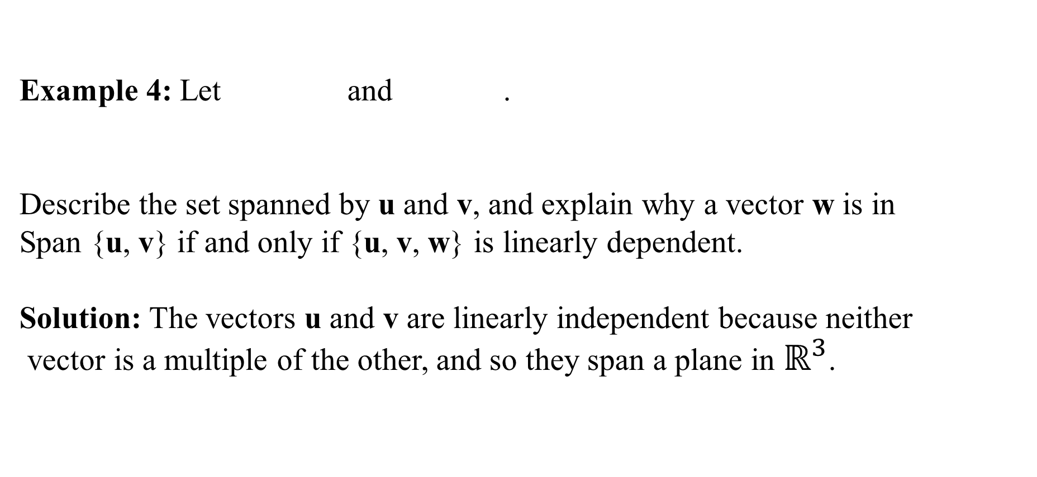
Set of One or Two Vectors
Example 4: Let and .
Describe the set spanned by u and v, and explain why a vector w is in
Span {u, v} if and only if {u, v, w} is linearly dependent.
Solution: The vectors u and v are linearly independent because neither
vector is a multiple of the other, and so they span a plane in $ℝ^{3}$.

Slide 14
Set of One or Two Vector
If w is a linear combination of u and v, then {u, v, w} is linearly dependent, by Theorem 7.
Conversely, suppose that {u, v, w} is linearly dependent.
By theorem 7, some vector in {u, v, w} is a linear combination of the preceding vectors (since ).
That vector must be w, since v is not a multiple of u.

Slide 15
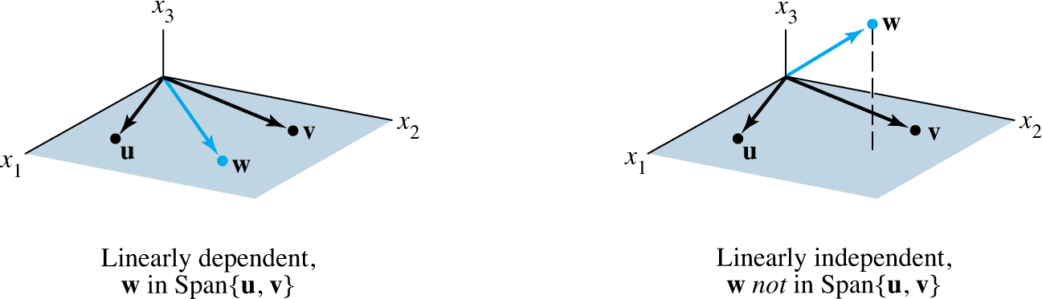
Set of Two or More Vectors
So w is in Span {u, v}. Fig. 2 below
The set {u, v, w} will be linearly dependent if and only if w is in the plane spanned by u and v.

Slide 16
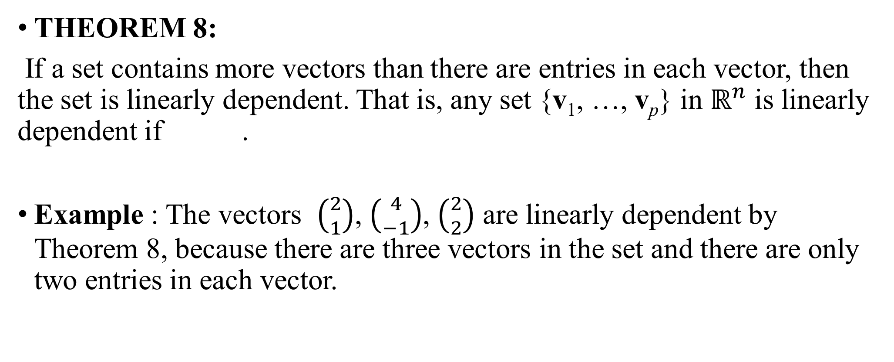
Set of Two or More Vectors
THEOREM 8:
If a set contains more vectors than there are entries in each vector, then the set is linearly dependent. That is, any set {v₁, …, v_{p}} in $ℝ^{n}$ is linearly dependent if .
Example : The vectors $\left({2 \atop 1}\right)$, $\left({4 \atop −1}\right)$, $\left({2 \atop 2}\right)$ are linearly dependent by Theorem 8, because there are three vectors in the set and there are only two entries in each vector.

Slide 17
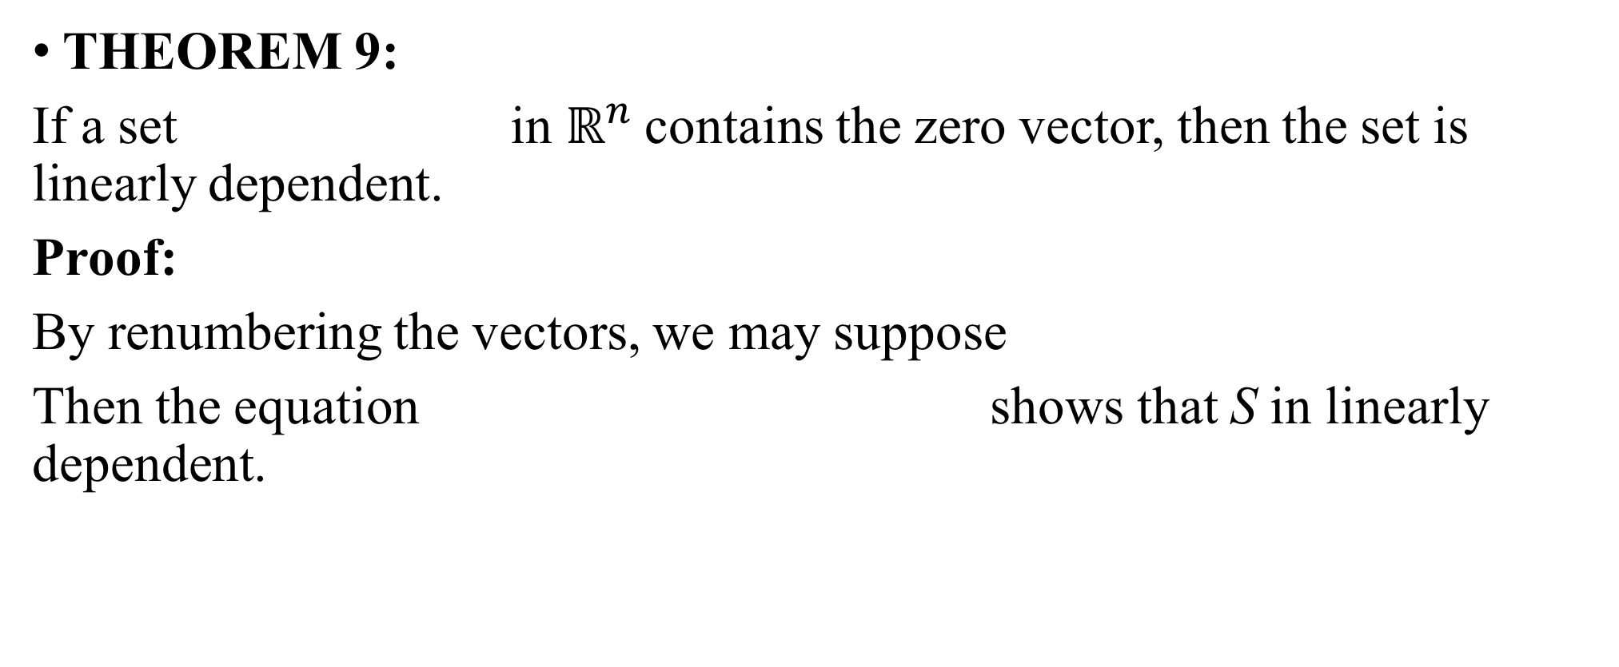
Set of Two or More Vectors
THEOREM 9:
If a set in $ℝ^{n}$contains the zero vector, then the set is linearly dependent.
Proof:
By renumbering the vectors, we may suppose
Then the equation shows that S in linearly dependent.

Slide 18
Introduction to
Linear transformations

Slide 19
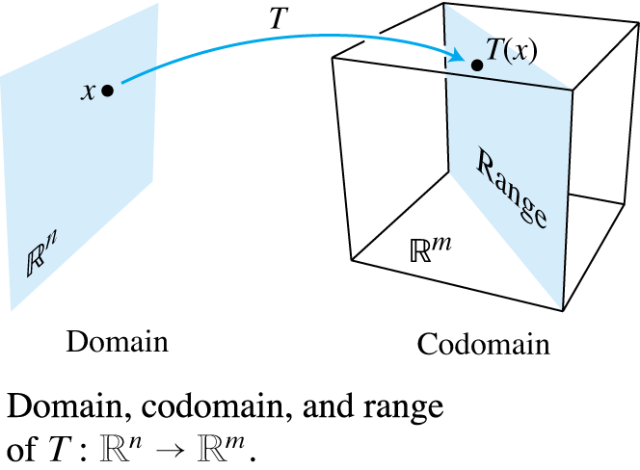

LINEAR TRANSFORMATIONS
The transformation (map)$T:ℝ^{n}→ℝ^{m}$ indicates that the domain of T is $ℝ^{n}$ and the codomain is $ℝ^{m}$.
For x in $ℝ^{n}$, the vector T (x) in $ℝ^{m}$ is called the image of x (under the action of T ).
The set of all images T (x) is called the range of T

Slide 20
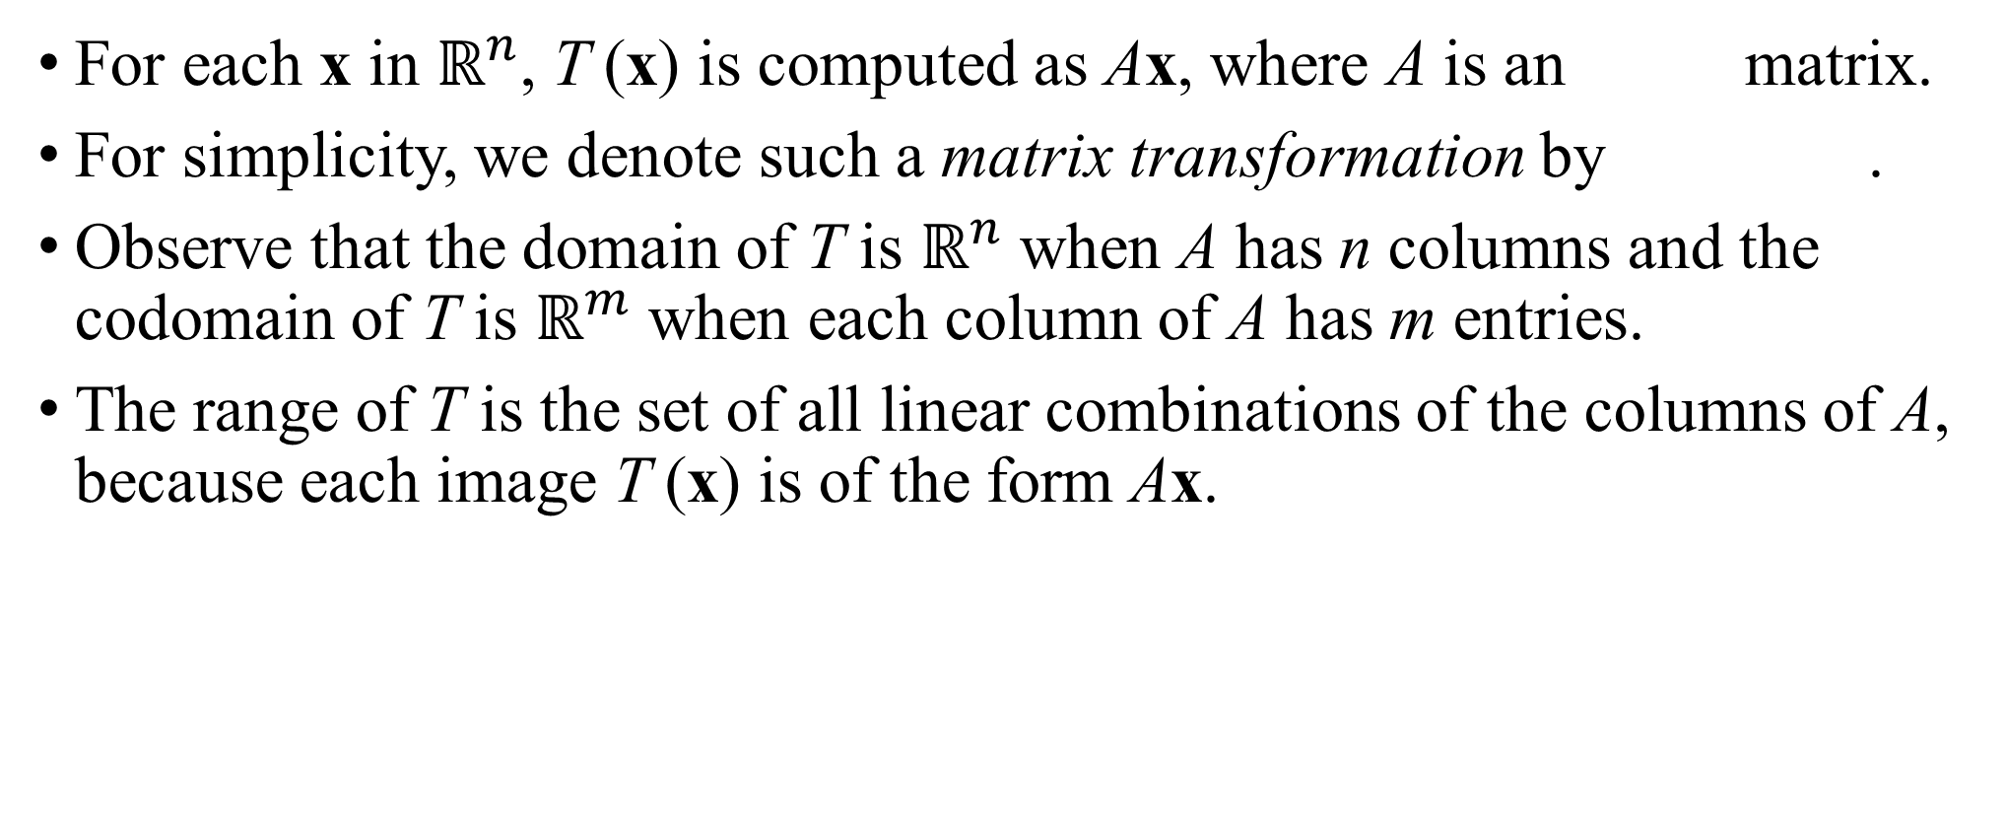
MATRIX TRANSFORMATIONS
For each x in $ℝ^{n}$, T (x) is computed as Ax, where A is an matrix.
For simplicity, we denote such a matrix transformation by .
Observe that the domain of T is $ℝ^{n}$ when A has n columns and the codomain of T is $ℝ^{m}$ when each column of A has m entries.
The range of T is the set of all linear combinations of the columns of A, because each image T (x) is of the form Ax.

Slide 21

MATRIX TRANSFORMATIONS
Example 1:
Let , , $b= \left[\begin{aligned}3 \\ 2 \\ −5\end{aligned}\right]$, c$=\left[\begin{aligned}3 \\ 2 \\ 5\end{aligned}\right]$.
and define a transformation $T:ℝ^{n}→ℝ^{m}$ by , so that

Slide 22
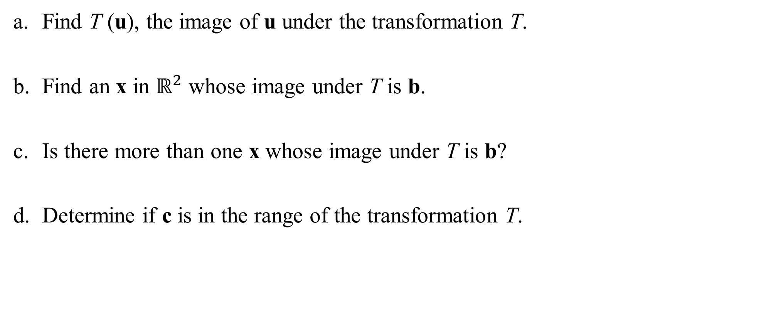
Linear transformation
Find T (u), the image of u under the transformation T.
Find an x in $ℝ^{2}$ whose image under T is b.
Is there more than one x whose image under T is b?
Determine if c is in the range of the transformation T.

Slide 23
Linear Transformations
Solution:
Compute
Solve for x. That is, solve , or
(1)

Slide 24
Linear Transformations
Row reduce the augmented matrix:
(2)
Hence , , and
The image of this x under T is the given vector b.

Slide 25
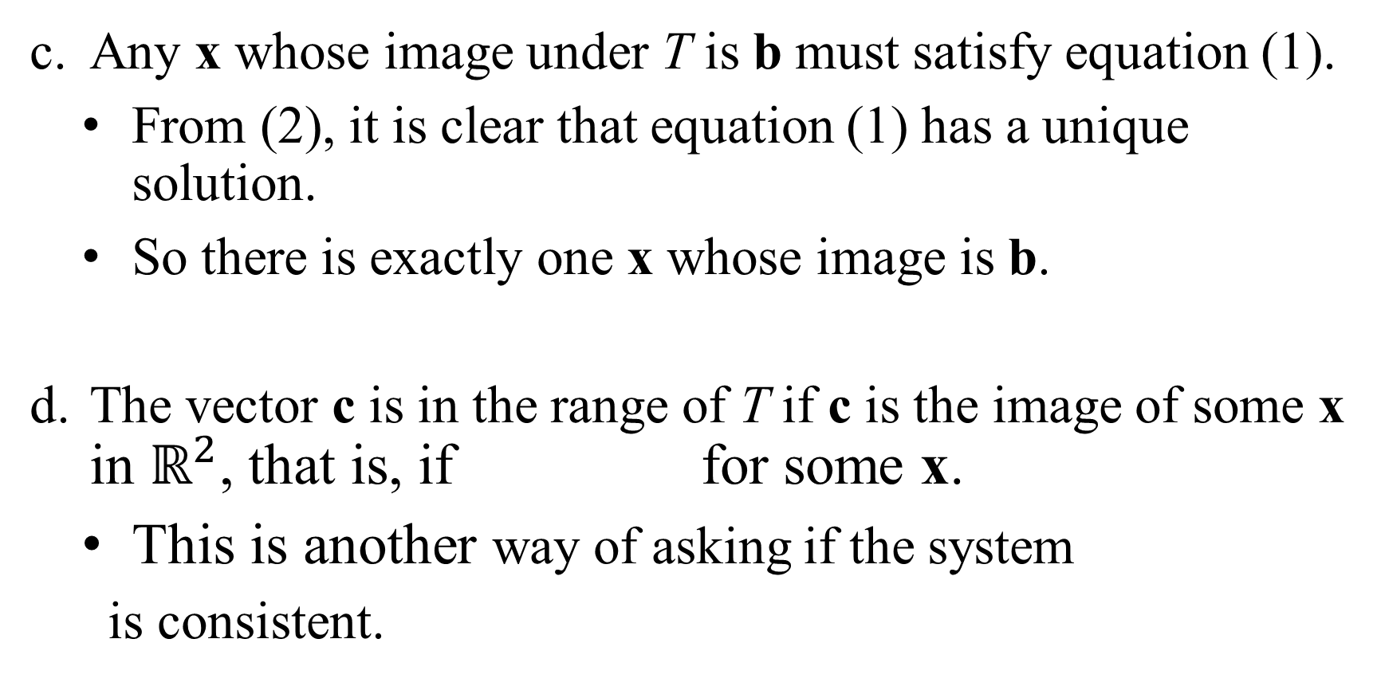
Linear Transformations
Any x whose image under T is b must satisfy equation (1).
From (2), it is clear that equation (1) has a unique solution.
So there is exactly one x whose image is b.
The vector c is in the range of T if c is the image of some x in $ℝ^{2}$, that is, if for some x.
This is another way of asking if the system
is consistent.

Slide 26


Linear Transformations
To find the answer, row reduce the augmented matrix:
The third equation, , shows that the system is inconsistent.
So c is not in the range of T.
$$\sim$$
$$\sim \sim$$
$$\sim \sim$$

Slide 27
Linear Transformations
Definition: A transformation (or mapping) T is linear if:
for all u, v in the domain of T;
for all scalars c and all u in the domain of T.
These two properties lead to the following useful facts.
If T is a linear transformation, then (3)
and . (4)
Generation case :

Slide 28
THE MATRIX OF A
LINEAR TRANSFORMATION

Slide 29

THE MATRIX OF A LINEAR TRANSFORMATION
THEOREM 10 : Let T: $ℝ^{n}→ℝ^{m}$ be a linear transformation. Then there exists a unique matrix A such that
$T\left(x\right)=Ax$ for all x in${ ℝ}^{n}$
In fact, A is the $m×n \text{matrix} \text{whose} \text{j} \text{th} \text{column} \text{is} \text{the} \text{vector} T(e_{j})\text{, }\text{where} e_{j} \text{is} \text{the} \text{j} \text{th} \text{column} \text{of} \text{the} \text{identity} \text{matrix} \text{in} ℝ^{n}$
$A=[T(e_{1})\text{...}T(e_{n})\text{]}$

Slide 30
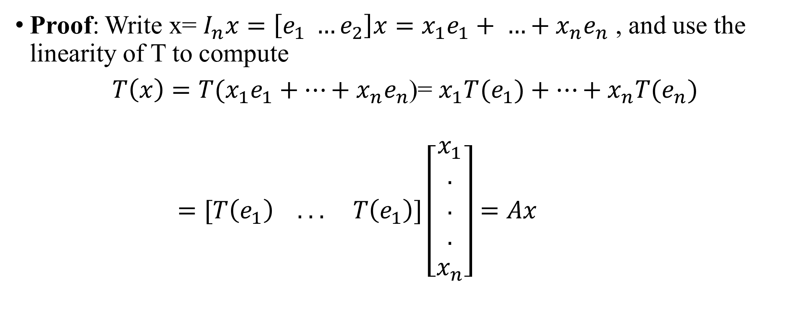
The Matrix of Linear Transformations
Proof: Write x= $I_{n}x=\left[e_{1} …e_{2}\right]x=x_{1}e_{1}+ …+x_{n}e_{n}$ , and use the linearity of T to compute
$T\left(x\right)=T(x_{1}e_{1}+…+x_{n}e_{n}$)= $x_{1}T{(e}_{1})+…+x_{n}T{(e}_{n})$
$=[T\left(e_{1}\right) \text{. . .} T\left(e_{1}\right)\text{]}\left[\begin{aligned}x_{1} \\ . \\ . \\ . \\ x_{n}\end{aligned}\right]=Ax$

Slide 31
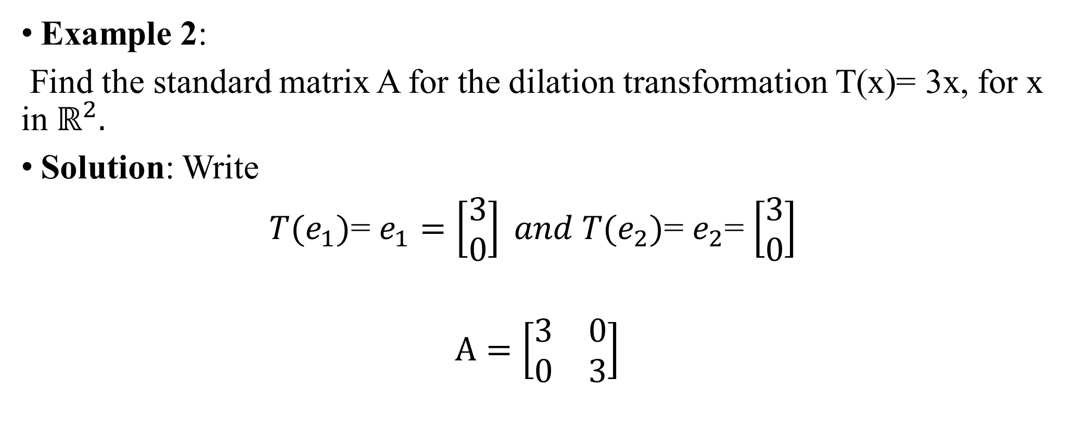
The Matrix of Linear Transformations
Example 2:
Find the standard matrix A for the dilation transformation T(x)= 3x, for x in $ℝ^{2}.$
Solution: Write
$T{(e}_{1})$= $e_{1}=\left[\begin{aligned}3 \\ 0\end{aligned}\right] and T{(e}_{2})$= $e_{2}$= $\left[\begin{aligned}3 \\ 0\end{aligned}\right]$
$A=\left[\begin{matrix}3 & 0 \\ 0 & 3\end{matrix}\right]$

Slide 32
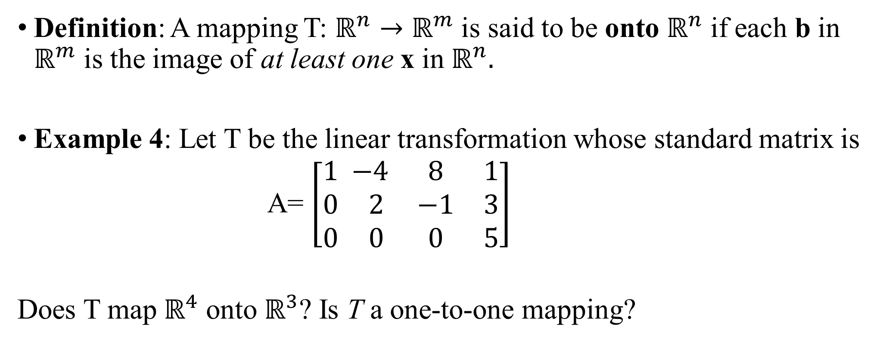
EXISTENCE AND UNIQUENESS QUESTIONS
Definition: A mapping T: $ℝ^{n}→ℝ^{m}$ is said to be onto $ℝ^{n}$ if each b in $ℝ^{m}$ is the image of at least one x in${ ℝ}^{n}.$
Example 4: Let T be the linear transformation whose standard matrix is
A= $\left[\begin{aligned}1 \\ 0 \\ 0\end{aligned}\begin{matrix} −4 & 8 & 1 \\ 2 & −1 & 3 \\ 0 & 0 & 5\end{matrix}\right]$
Does T map $ℝ^{4}$ onto $ℝ^{3}$? Is T a one-to-one mapping?

Slide 33
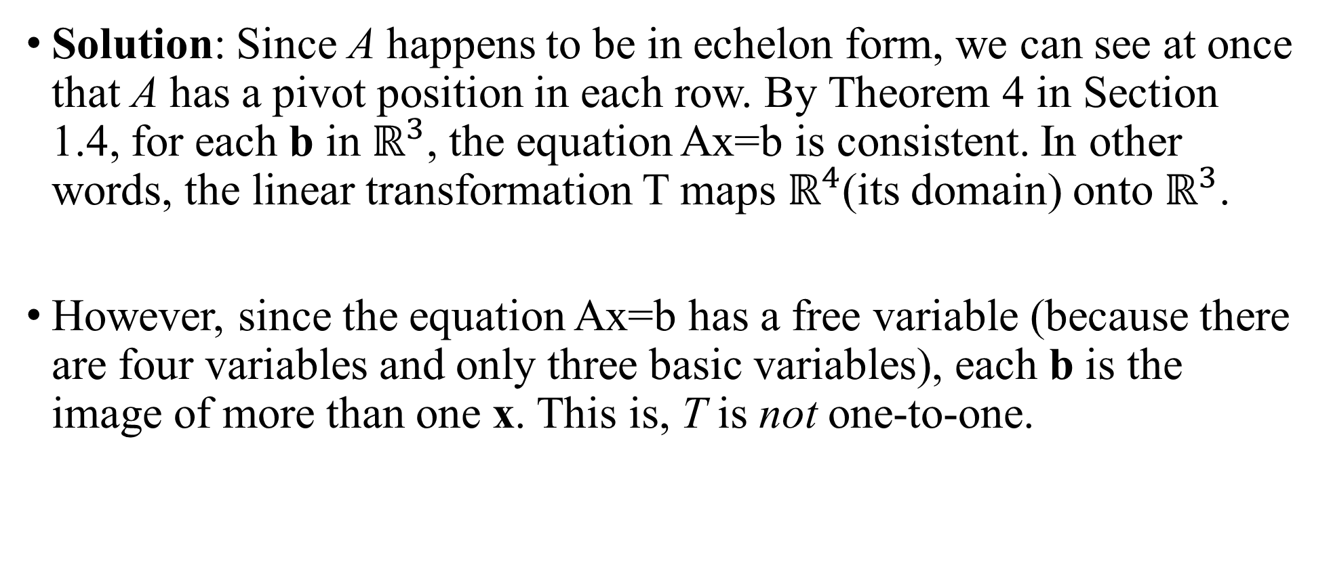
EXISTENCE AND UNIQUENESS QUESTIONS
Solution: Since A happens to be in echelon form, we can see at once that A has a pivot position in each row. By Theorem 4 in Section 1.4, for each b in $ℝ^{3}$, the equation Ax=b is consistent. In other words, the linear transformation T maps $ℝ^{4}$(its domain) onto $ℝ^{3}$.
However, since the equation Ax=b has a free variable (because there are four variables and only three basic variables), each b is the image of more than one x. This is, T is not one-to-one.

Slide 34
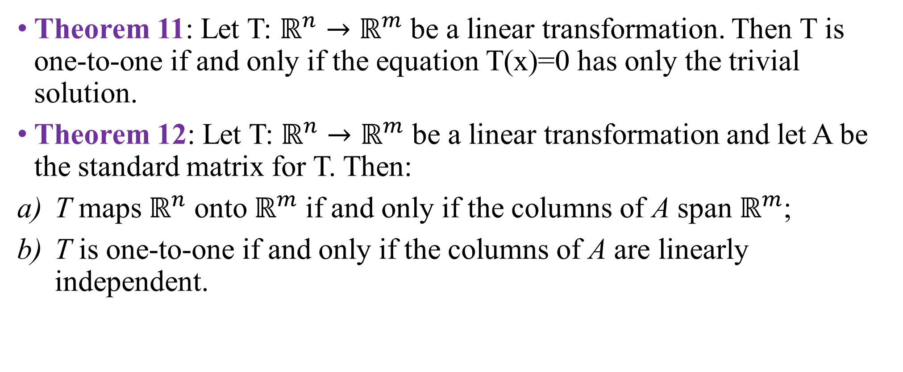
EXISTENCE AND UNIQUENESS QUESTIONS
Theorem 11: Let T: $ℝ^{n}→ℝ^{m}$ be a linear transformation. Then T is one-to-one if and only if the equation T(x)=0 has only the trivial solution.
Theorem 12: Let T: $ℝ^{n}→ℝ^{m}$ be a linear transformation and let A be the standard matrix for T. Then:
T maps $ℝ^{n}$ onto${ ℝ}^{m}$ if and only if the columns of A span $ℝ^{m}$;
T is one-to-one if and only if the columns of A are linearly independent.

Slide 35
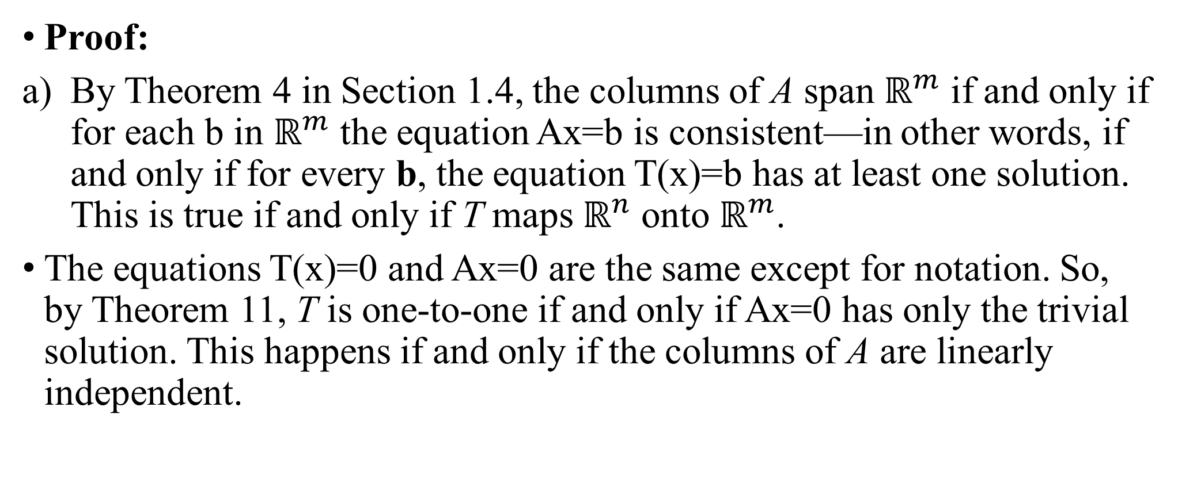
EXISTENCE AND UNIQUENESS QUESTIONS
Proof:
By Theorem 4 in Section 1.4, the columns of A span $ℝ^{m}$ if and only if for each b in $ℝ^{m}$ the equation Ax=b is consistent—in other words, if and only if for every b, the equation T(x)=b has at least one solution. This is true if and only if T maps $ℝ^{n}$ onto $ℝ^{m}$.
The equations T(x)=0 and Ax=0 are the same except for notation. So, by Theorem 11, T is one-to-one if and only if Ax=0 has only the trivial solution. This happens if and only if the columns of A are linearly independent.

Slide 36
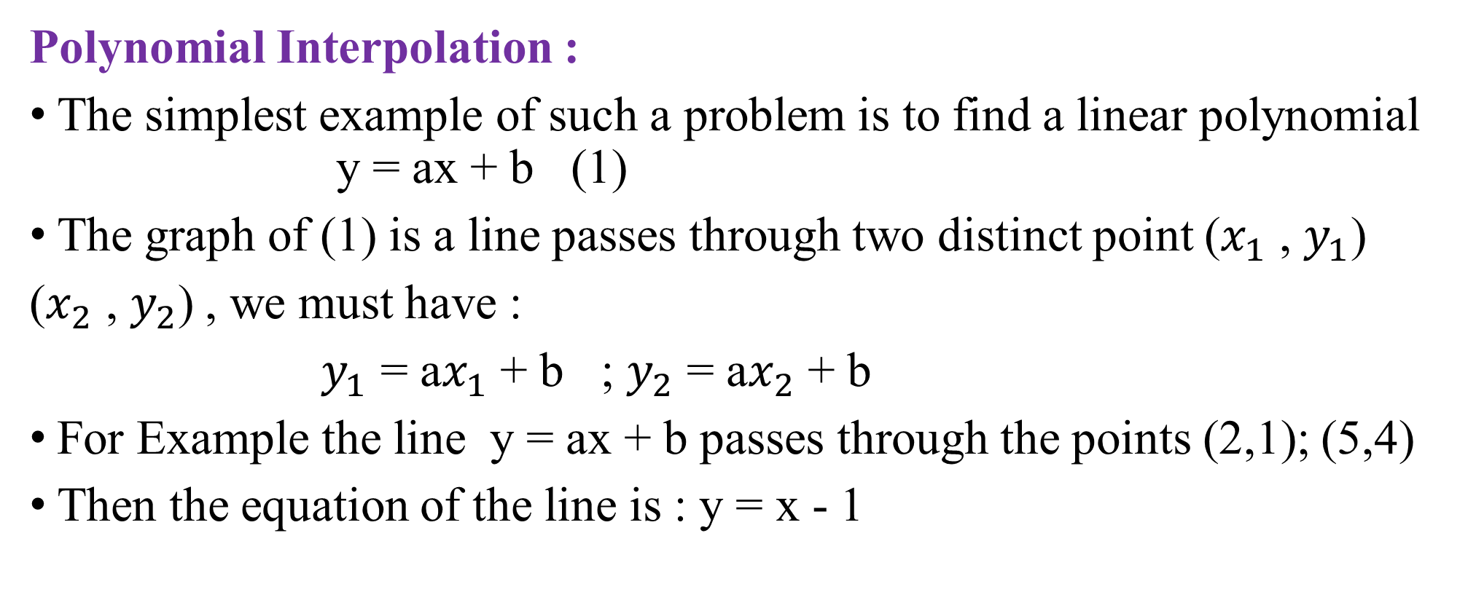
An Application of Linear Symstem
Polynomial Interpolation :
The simplest example of such a problem is to find a linear polynomial y = ax + b (1)
The graph of (1) is a line passes through two distinct point ($x_{1}$ , $y_{1}$)
($x_{2}$ , $y_{2}$) , we must have :
$y_{1}$ = a$x_{1}$ + b ; $y_{2}$ = a$x_{2}$ + b
For Example the line y = ax + b passes through the points (2,1); (5,4)
Then the equation of the line is : y = x - 1

Slide 37
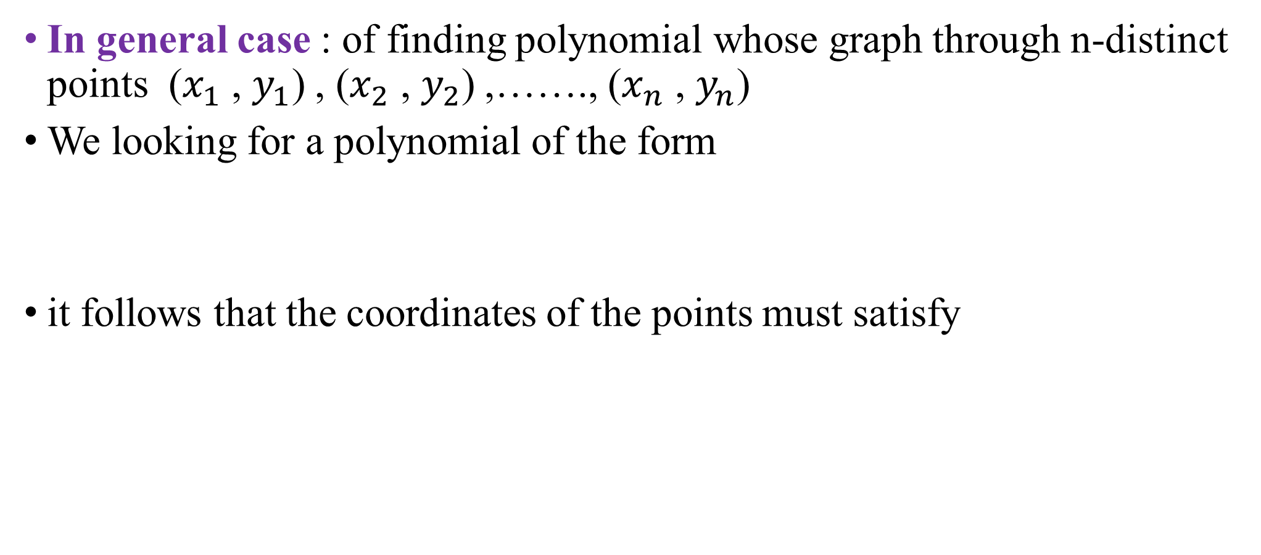
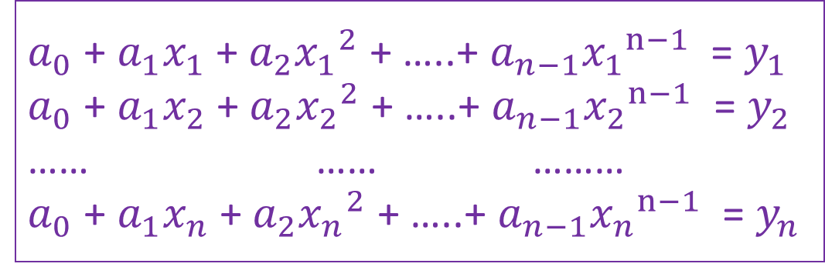
Polynomial Interpolation
In general case : of finding polynomial whose graph through n-distinct points ($x_{1}$ , $y_{1}$) , ($x_{2}$ , $y_{2}$) ,……., ($x_{n}$ , $y_{n}$)
We looking for a polynomial of the form
it follows that the coordinates of the points must satisfy
p(x) = $a_{0}$ + $a_{1}$x + $a_{2}x^{2}$ + …..+ $a_{n−1}x^{n−1}$
$a_{0}$ + $a_{1}x_{1}$ + $a_{2}{x_{1}}^{2}$ + …..+ $a_{n−1}{x_{1}}^{n−1}$ = $y_{1}$
$a_{0}$ + $a_{1}x_{2}$ + $a_{2}{x_{2}}^{2}$ + …..+ $a_{n−1}{x_{2}}^{n−1}$ = $y_{2}$
…… …… ………
$a_{0}$ + $a_{1}x_{n}$ + $a_{2}{x_{n}}^{2}$ + …..+ $a_{n−1}{x_{n}}^{n−1}$ = $y_{n}$

Slide 38
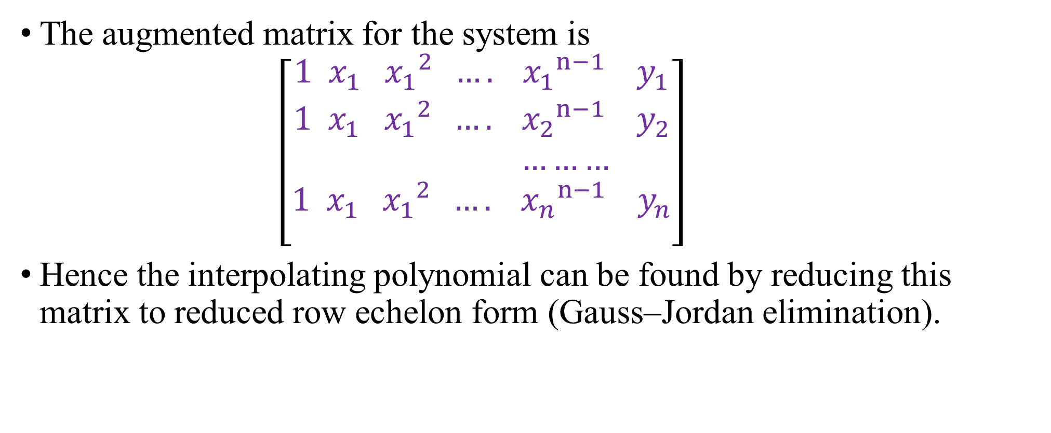
Polynomial Interpolation
The augmented matrix for the system is
$\left[\begin{aligned}1{ x}_{1}{{ x}_{1}}^{2} ….{{ x}_{1}}^{n−1}{ y}_{1} \\ 1{ x}_{1}{{ x}_{1}}^{2} ….{{ x}_{2}}^{n−1}{ y}_{2} \\ ……… \\ 1{ x}_{1}{{ x}_{1}}^{2} ….{{ x}_{n}}^{n−1}{ y}_{n} \\ \end{aligned}\right]$
Hence the interpolating polynomial can be found by reducing this matrix to reduced row echelon form (Gauss–Jordan elimination).

Slide 39
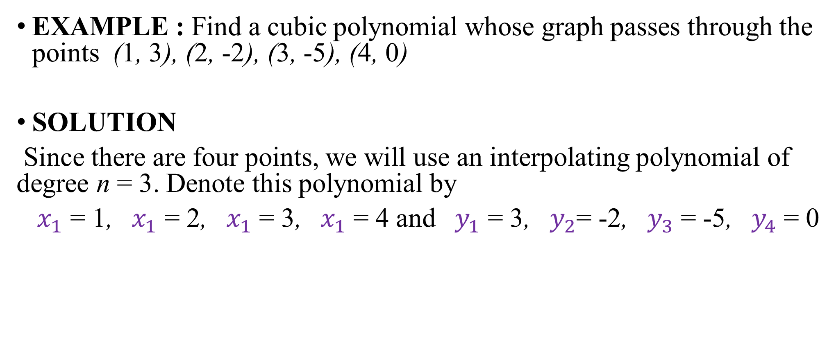
EXAMPLE : Find a cubic polynomial whose graph passes through the points (1, 3), (2, -2), (3, -5), (4, 0)
SOLUTION
Since there are four points, we will use an interpolating polynomial of degree n = 3. Denote this polynomial by
$x_{1}$ = 1, ${ x}_{1}$ = 2, ${ x}_{1}$ = 3, ${ x}_{1}$ = 4 and ${ y}_{1}$ = 3, ${ y}_{2}$= -2, ${ y}_{3}$ = -5, ${ y}_{4}$ = 0

Slide 40
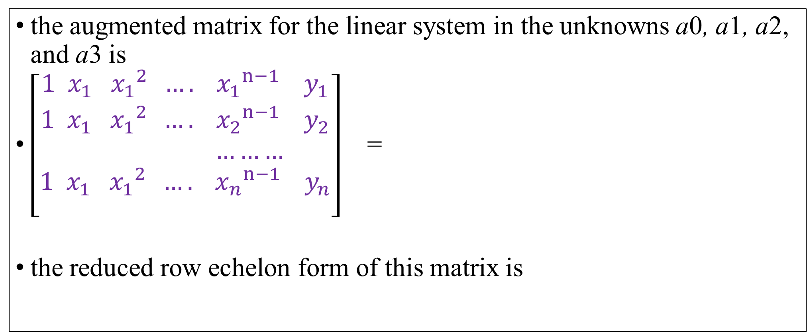
Polynomial Interpolation
the augmented matrix for the linear system in the unknowns a0, a1, a2, and a3 is
$\left[\begin{aligned}1{ x}_{1}{{ x}_{1}}^{2} ….{{ x}_{1}}^{n−1}{ y}_{1} \\ 1{ x}_{1}{{ x}_{1}}^{2} ….{{ x}_{2}}^{n−1}{ y}_{2} \\ ……… \\ 1{ x}_{1}{{ x}_{1}}^{2} ….{{ x}_{n}}^{n−1}{ y}_{n} \\ \end{aligned}\right]$ =
the reduced row echelon form of this matrix is

Slide 41

Polynomial Interpolation
from which it follows that a0 = 4, a1 = 3, a2 = -5, a3 = 1. Thus, the interpolating polynomial is
p(x) = 4 + 3x - 5$x^{2}$ + $x^{3}$

Slide 42
Thank you for Listening

